Slide 1
Abstraction
Notes:
Pre-assessment: Turn and share what you think abstraction means.

Slide 2
I can listen to others and respectfully add my thoughts.
I can identify the most important features (parts) of an object.
I can define abstraction.

Slide 3

At the end of the video, you will share with a partner something that you learned, noticed, or wonder.
I think ______________.
I wonder ____________.
I noticed _____________.

Slide 4
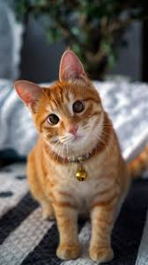
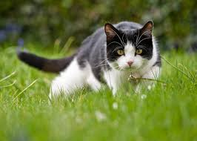
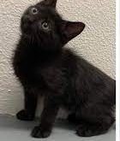

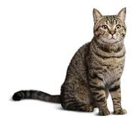
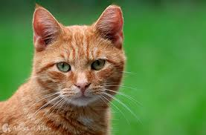

Slide 5
Abstraction
Taking something complex and making it simpler
Removing unnecessary parts or information
Notes:
Introduce the concept of abstraction. “This is when you take something that is very complex and you pick out the most important parts/features.” Refer back to the cat activity (slides) and then show abstractions of other objects and have students tell you what they represent.

Slide 6


Which one of these pictures is an abstraction of a cat?
How many features does the abstraction include?

Slide 7
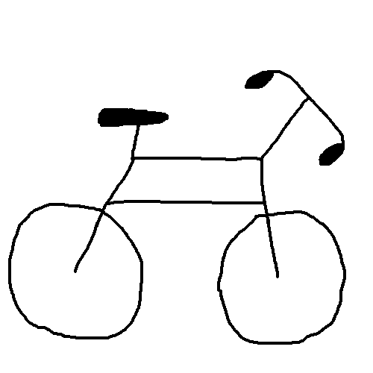
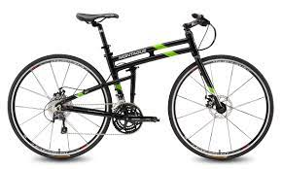
Look at the abstraction picture.
What do you think the abstract picture is showing?
How many features are included in this abstraction?
Why are those features important?
Notes:
Show abstractions of other objects and have students tell you what they represent.
Note: When in slideshow mode, click the slide to show the answer to the students.

Slide 8


Look at the abstraction picture.
What do you think the abstract picture is showing?
I think it is an abstraction of a _________ because _________.
Notes:
Show abstractions of other objects and have students tell you what they represent.
Note: When in slideshow mode, click the slide to show the answer to the students.

Slide 9
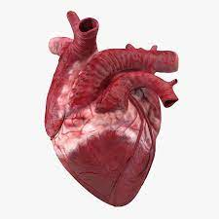

Look at the abstraction picture.
What do you think the abstract picture is showing?
I think it is an abstraction of a _________ because _________.
Notes:
Show abstractions of other objects and have students tell you what they represent.
Note: When in slideshow mode, click the slide to show the answer to the students.

Slide 10
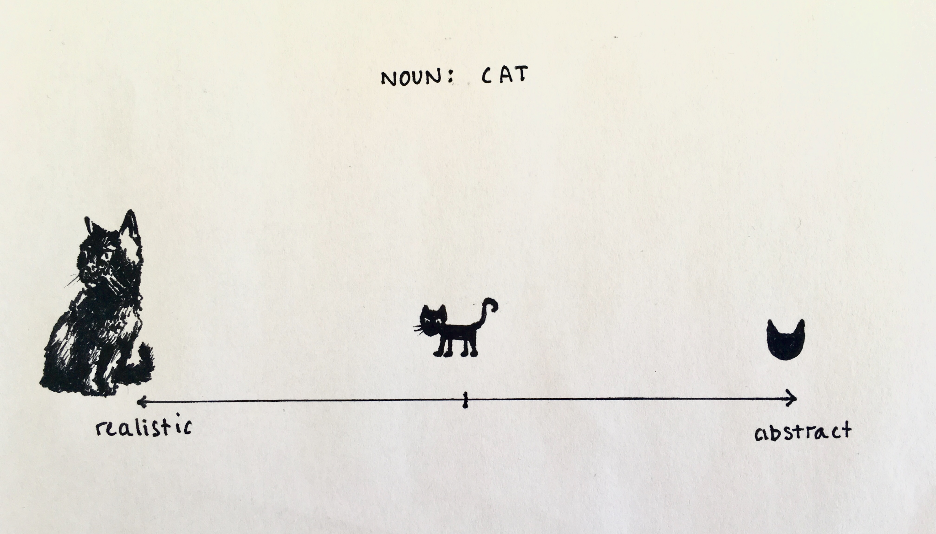

Slide 11
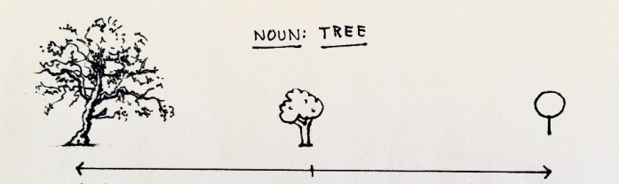

Slide 12
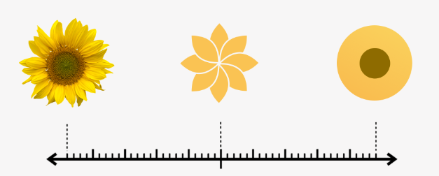

Slide 13
Abstraction
Taking something complex and making it simpler
Removing unnecessary parts or information
Notes:
Introduce the concept of abstraction. “This is when you take something that is very complex and you pick out the most important parts/features.” Refer back to the cat activity (slides) and then show abstractions of other objects and have students tell you what they represent.

Slide 14
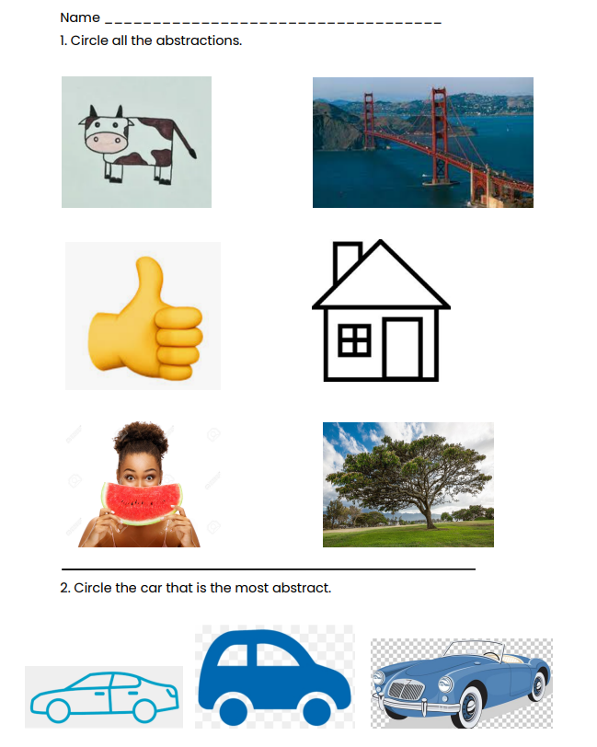
Post-assessment
Notes:
Post-assessment

Slide 15

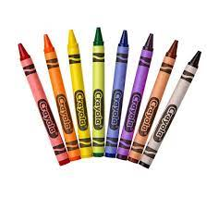


Materials
Blank paper | Pencil | Crayons
Notes:
“Now that we have learned about cats, you are going to get some materials. Your goal is to draw a cat.” They can color it when they are done. As students draw, the teacher will be making tape bubbles so the students can place their cat picture up when they are done. Make a list.

Slide 16


Materials
Blank paper | Pencil | Crayons | Class Cat List
Notes:
“Now you are going to draw a cat again. But this time you will choose only 5 parts of a cat from our list. Your drawing should look like a cat when you are done.” Give students about 5 minutes. They can color it when they are done.
Note: if a student wants/needs a challenge then you can have them draw the animal with 3 most important parts.
As students draw, the teacher will create bubble tapes on a space near the first drawings so the new drawings can be hung up.

